Slide 1
Recruiting Challenges
Finding a Needle
in a Small Haystack

Slide 2
Recruiting Challenges Finding a Needle in a Small Haystack
Introduction
Back To Basics- Traditional Resources
Creative Resources
Free Resources
Social Media as a Resource
Conclusion

Slide 3
Recruiting Challenges Finding a Needle in a Small Haystack
The national unemployment rate is at 5% (BLS for September 2016)
The Arizona unemployment rate is at 5.8% (AZ ranks 45th, with Alaska at the highest 6.8 % and South Dakota the lowest at 2.9%)
Phoenix/Mesa/Glendale at 4.6% unemployment rate
Prescott unemployment rate at 4.7%

Slide 4
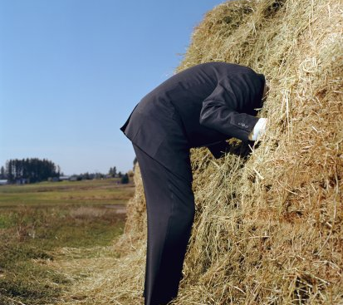
What do I do now?
Ignore it
Take Action
Live It! *

Slide 5
Back to Basics- Traditional Resources
Local newspaper ads
Community papers
Chamber of Commerce
Local government websites:
City of Prescott http://www.prescott- az.gov/events/
Town of Prescott http://www.pvaz.net/calendar.aspx
Community events
Employee referral program

Slide 6
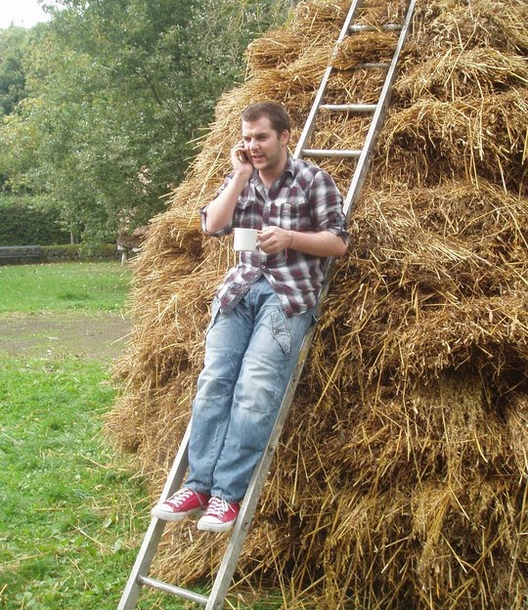
Employee Referral Program
We all know someone looking for a job
Doesn’t have to be expensive
The cost of an employment ad ($50-$300)
PTO day
Recognition
May be seasonal or job specific

Slide 7
Creative Resources
Open House- meet them where they are (early morning, evenings, weekend)
Advertise in your own lobby/delivery area (let vendors be your voice)
Sponsor a local activity- i.e. community walk/run and use your parking lot as a staging area
Advertise at local high school reunions
Create incubators- evening skills training, training from within
Be flexible- part time hours, job share

Slide 8
Creative Resources
Vehicle decals, wraps or clings
Offer parts of your building or conference room for use- i.e. book clubs, Girl Scout meetings, CPR classes
Offer your parking lot- i.e. employee ‘garage’ sale, holiday bake sale, car show
Local bulletin boards- Starbucks, Wal-Mart
Become the town hero- 4-H club, burger building contest

Slide 9
Creative Resources
Speak to high school seniors- make contact with the Careers dept. and ask to be a guest speaker
Partner with local police & DMV office- if a clean driving/background record is important- hold a class with 16 year old's & parents and speak on why it is important to keep records clean
Advertise at the movie theatres

Slide 10
Creative Resources
Purchase ‘I’m hiring’ business cards and leave with people in town that give you great service
Develop relationships with realtors who can tip you off to people relocating to the area
Host a free resume critique or interviewing skills class- you may find some future talent

Slide 11
Free Resources
Local Unemployment Office-
Arizona Dept. of Economic Security/Arizona at Work- DES Job Bank- place job orders directly with DES by completing a Job Order form https://des.az.gov/services/employment/employers/employment-service-employee-recruitment-through-des-employment-service
www.AZjobconnection.gov -free resume search and job postings, hiring events, West Prescott office on Marina St. (928) 778-1422
Veteran’s Organizations-
www.valueofaveteran.com -good resources and access to job fair schedules
AZ Disabled Employment Veterans Representation office https://des.az.gov/services/employment/veterans/arizona-local-and-disabled-veteran-employment-representative-directory -Prescott Valley office on Bob Drive (928) 759-1678

Slide 12
Free Resources
Local Colleges-
NAU- free job board- ‘Jobs for Jacks’ http://nau.edu/career/jobs-for-jacks/
ASU- free job board https://eoss.asu.edu/cs/employers
U of A- annual job fair, job posting for a fee https://career.arizona.edu/welcome-employers
Maricopa County Community Colleges- free job board ‘Maricopa Career Network’ https://secure.jobing.com/ec/postajob.asp?ProfileID=669
Yavapai College- free job board https://www.yc.edu/v5content/regional-economic-development-center/openings.htm

Slide 13
Free Resources
Job boards-
iKrut- free job board postings and ATS www.iKrut.com
Zip Recruiter, Indeed, Glass Door, Snagajob- free for 30 day trial
Recuiting.com (aka Jobing.com)- free sourcing tool https://sourcing.recruiting.com/

Slide 14
Free Resources
Staffing Firms- Robert Half lets you view resumes for free-(25 pages of driver profiles) https://www.roberthalf.com/phoenix?medium=tsa&gclid=CPPD07j7lM8CFZBZhgodBlEOiQ&gclsrc=aw.ds
Post jobs at local library, YMCA
Free press, radio stations/newspapers

Slide 15
Social Media as a Resource
Facebook- Create a business page; launch a FB campaign with your employees
Twitter- post snippets of what your employees are doing, i.e. Employee of the Month, Safety Awards
LinkedIn- Create a business page; post industry articles, employee pictures, employee activities, create a group, saved Advanced Searches
Meet Up- post an activity at your facility, i.e. book club, yoga classes, car shows
Hootsuite.com

Slide 16
Social Media as a Resource
Employer branding- i.e. storyboard video
Text recruiting-(15 day free trial) http://www.textrecruit.com/sign-up/?gclid=COmcjuuDlc8CFc5ZhgodYlsPbg
Job boards- Indeed, CareerBuilder, Jobing.com, Craigslist
Skype and Face Time interviews

Slide 17
LinkedIn.com
Advanced People Search
Create detailed searches and save (5-7)
Narrow search to Location, Company, Industry, Educations, Seniority Level, Years of Experience, Function, Interests, Language
Connect with people daily to grow your network
Send regular In-mails

Slide 18
Live it !
HR and Business Owners- Constant Recruiting
Recruiting top talent is an exercise in marketing- you must identify your target audience and tailor your message to them
Don’t be afraid to recruit in big markets
Update job postings to reflect attractions- low cost of living, low crime rate, four mild seasons, culture, quality of life

Slide 19
Live it !

Slide 20
Live it !
Interview unconventionally
You’ve got to get really personal-this is about life, not just a career
What are their likes/dislikes/hobbies?
Spouse/children?
Where did they grow up?
Establish a formal process for familiarizing candidates with your city
Stay in touch

Slide 21
Live it !
Sell Your Strengths
Flexibility- little bureaucracy
Prominence- no longer a small fish in a big pond
Drivable distance to large cities (Phoenix, San Diego, Las Vegas) emphasize the two and four hour radius
Compensation- cost of living
Traffic- shorter commute
Geography, climate, air quality
Community feel, family focus, schools, arts & culture, town’s ‘claim to fame’

Slide 22
Conclusion
Do something to reach candidates every day- Live It!
Use a variety of resources and methods
Meet them where they are
Be open to creativity in the sourcing process
Don’t be afraid of social media- use it to your advantage while you can

